Slide 1








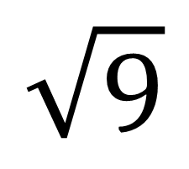
My Measurement Interactive Notebook
Name
Class:
Teacher:
Term 2 Semester 1

Slide 2
Contents
Glossary or Formula Page
Page
Date
Description
2

Slide 3
Tasks
24
7
30
Essential Question
Questions
Notes
Summary
6

Slide 4
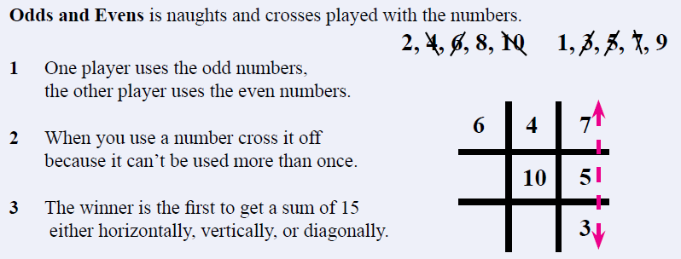
A Game!
Notes:
Set

Slide 5
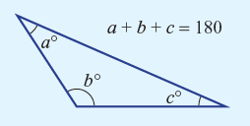
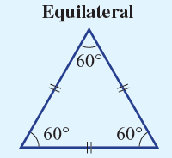
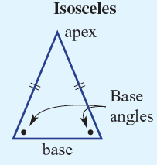
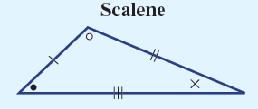
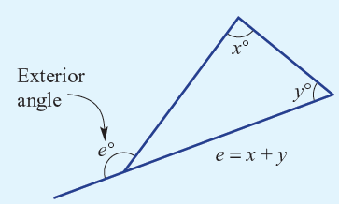
24
7
30
Date
Angle Properties
EQ – What rules help us when working with angles?
What are the properties of a triangle?
Triangles have…
3 sides
3 vertices
3 interior angles
The sum of the interior angles is 180°
Equilateral triangle: all angles must equal 60°
Isosceles triangle: 2 of the angles are the same (not the angle formed by the equal sides)
Scalene triangle: all angles are different
The exterior angle of a triangle is equal to the sum of the two opposite interior angles.

Slide 6
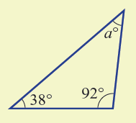
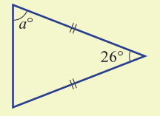
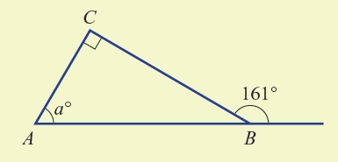




Let’s do these together

Slide 7
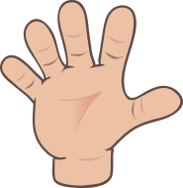
Do you understand? Fists of Five
Notes:
Check for Understanding

Slide 8
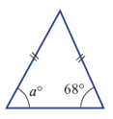
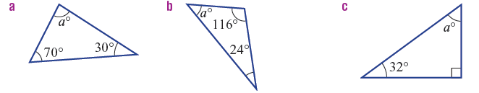
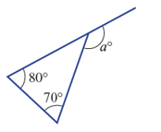
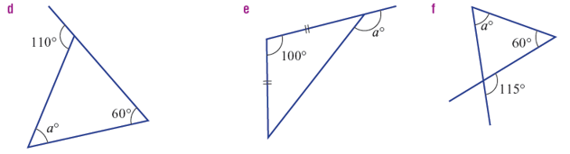
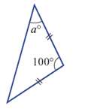
Activity- Find the value of angle ‘a’

Slide 9
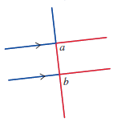

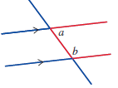
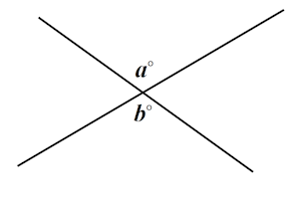
24
7
30
Date
Angle Properties
EQ – What rules help us when working with angles?
What are the angle rules for parallel lines?
Corresponding angles are equal in size.
The position of corresponding angles is easy to remember it by the ‘F’ shape.
Alternate angles are equal in size
The position of alternate angles is seen by the ‘Z’ shape.
Co-interior angles add up to 180°.
remember it by the ‘C’ shape.
Vertically Opposite angles are equal in size.
remember it by the ‘X’ shape.

Slide 10
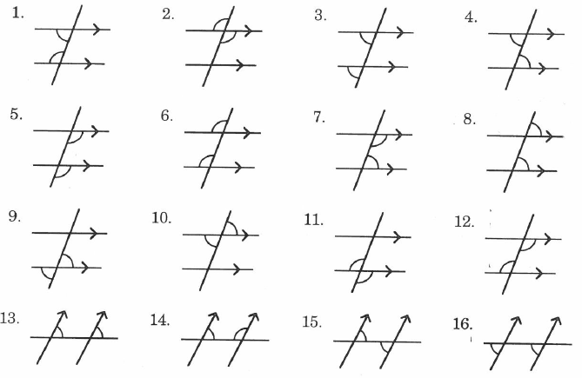
Let’s do these together
State whether these angles are corresponding (C), alternate (A), co-interior (CI) or vertically opposite (V).

Slide 11
Do you understand? Fists of Five
Notes:
Check for Understanding

Slide 12
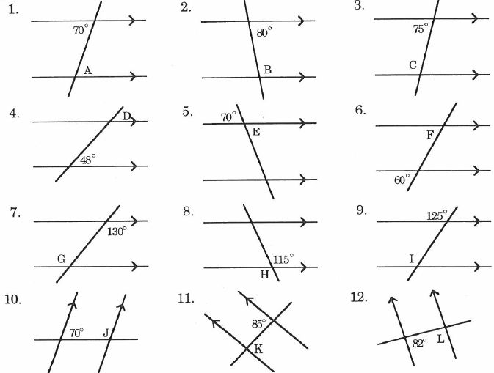
Now it’s your turn!
Find the value of the letter in each of these examples

Slide 13
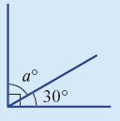
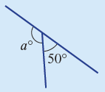
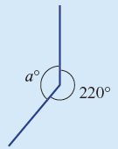
24
7
30
Date
Angle Properties
EQ – What rules help us when working with angles?
What are the angle rules at a point?
Complementary angles add to make 90°
Eg a° + 30° = 90°
a° = 90° - 30°
a° = 60°
Supplementary angles add to make 180°
Eg a° + 50° = 180°
a° = 180° - 50°
a° = 130°
Angles in a Revolution add to make 360°
Eg a° + 220° = 360°
a° = 360° - 220°
a° = 140°

Slide 14
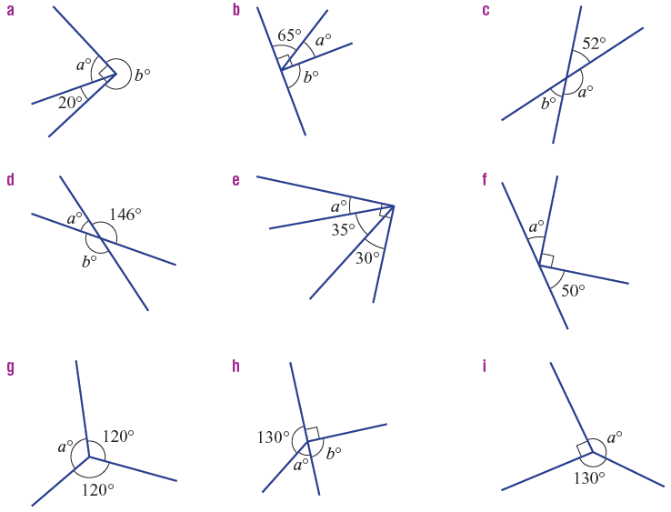
Let’s do these together
Find the value of the pronumeral.

Slide 15
Do you understand? Fists of Five
Notes:
Check for Understanding

Slide 16
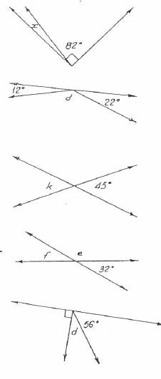
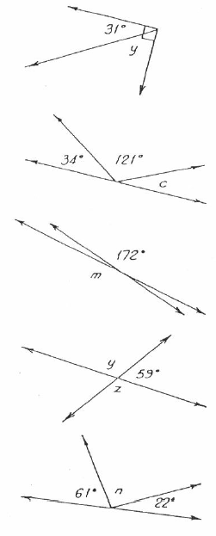
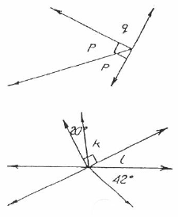
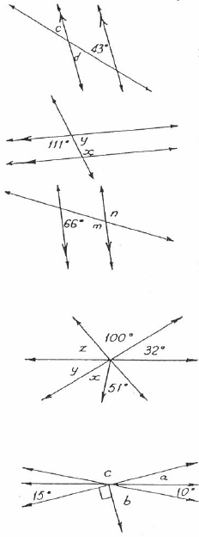
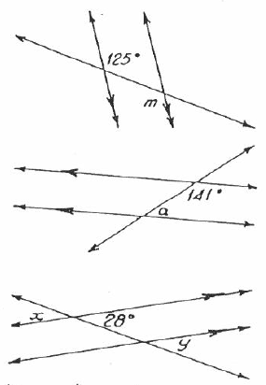
Now it’s your turn!
Find the value of the letter in each of these examples
1.
2.
3.
4.
5.
6.
7.
8.
9.
10.
11.
12.
13.
14.
15.
16.
17.
18.
19.
20.

Slide 17
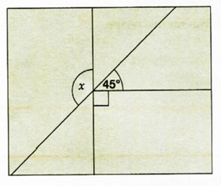
Final Challenge!- Calculate ‘x’

Slide 18
Notes Review
24, 7 ,30
Date
Title
Essential question
Notes complete
Notes complete with colour and diagrams
Questions completed
Contents page filled in
Formula page filled in

